Slide 1
VOXEL51
VISUAL AI HACKATHON
Flood_Fighters

Slide 2
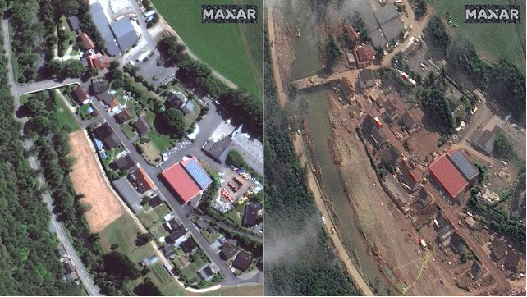
INTRODUCTION
Flooding is a natural disaster that causes significant damage to life, property, and the environment.
Emergency response teams play a vital role in disaster management, with crucial decisions during flood disasters that are indispensable.
Emergency response teams analyze satellite imagery for precise flood mapping, facilitating informed decisions by local authorities and enhancing flood impact mitigation.
Before Flood
After Flood

Slide 3
OBJECTIVE
To develop a semi-supervised DL based architecture which can train on images from a single satellite and test the model with images from multiple satellites.
To develop a reliable semi-supervised architecture that can be deployed to map flood images containing turbid water bodies.
To segment the images so that the water bodies and the land can be differentiated. This would help immediately spot onto where the flood has its main focus on.

Slide 4
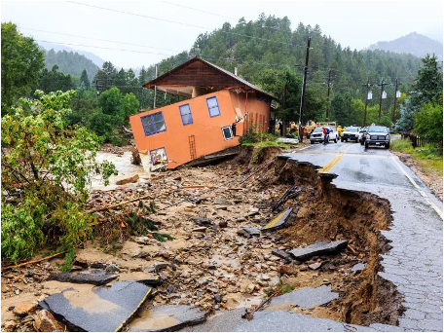
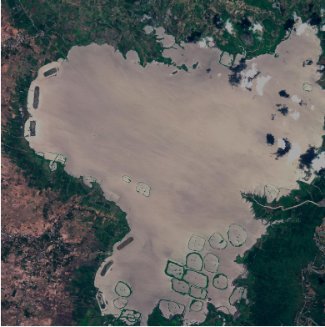
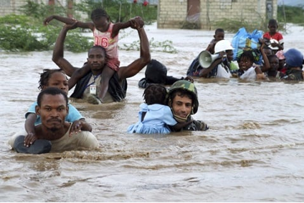
IMPACT OF FLOODS:
INFRASTRUCTURE & HUMAN CONSEQUENCES
Effect of floods on infrastructure
Satellite Image Showing flooded area
Effect of floods on humans

Slide 5
MOTIVE
Amid the torrential monsoon rains, disaster response teams race against time to aid flood-stricken communities. The satellite images are considered for recognizing all the flooded regions.
The challenge lies in making it accessible to those without technology expertise because the diverse satellite datasets, each with its unique complexities, have to be tamed.
That includes cleaning the dataset , along with the problems caused by spatial resolution which require immense amount of time, a model has to be developed that is tolerant to these anomalies.
The stakes are high, for a delayed response that could mean the difference between life and death for those trapped in the submerged areas.

Slide 6
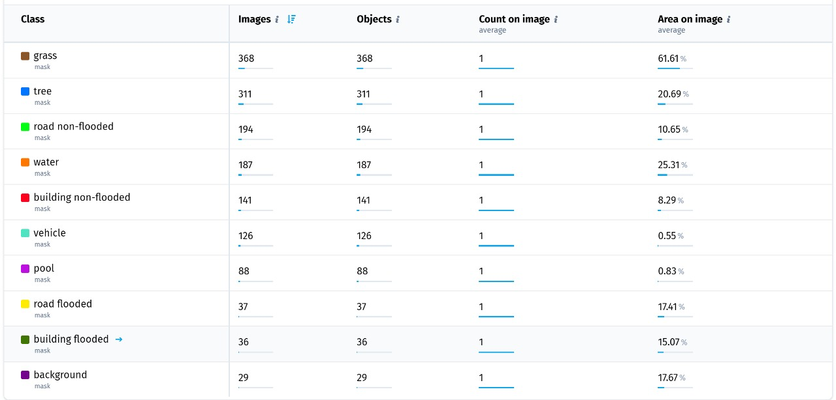
DATA
FloodNet is a High Resolution Aerial Imagery Dataset for semantic segmentation, classification, and semi supervised learning tasks. It is used in the search and rescue (SAR) and environmental industries.
The dataset consists of 2343 images with 1517 labeled objects belonging to 10 different classes including grass, tree, road non-flooded, and other: water, building non-flooded, vehicle, pool, road flooded, building flooded, and background. The dataset was released in 2020 by the UMBC, USA, Texas A&M University, and Dewberry, USA.
Below are the class labels for the annotated regions:

Slide 7
ABOUT SEGMENTATION
Image Segmentation: The task of dividing an image into segments (regions) that are meaningful, typically to simplify analysis.
Image segmentation in our case involves identifying flooded areas in satellite images.
Semantic Segmentation: Classifies each pixel in an image as belonging to a specific class (e.g., water, land, etc.).
Instance Segmentation: Differentiates between individual instances of the same class (e.g., identifying separate flood regions).

Slide 8
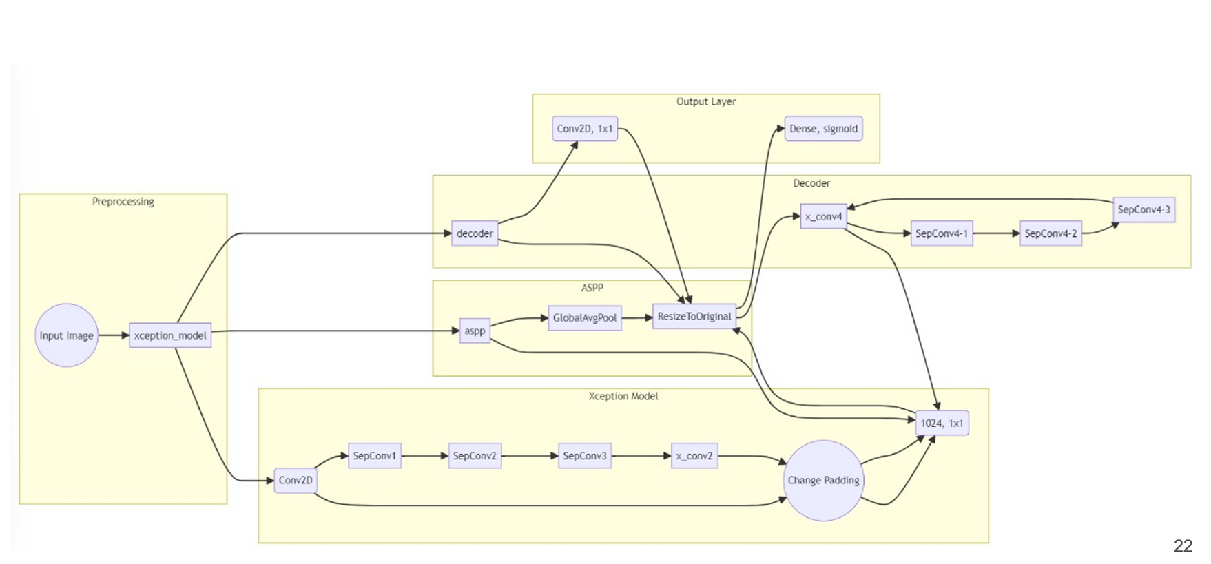
DEEPLAB-V3
DeepLabv3 is a state-of-the-art deep learning model designed for semantic image segmentation, which is the task of classifying each pixel in an image into a category.
It uses a modified ResNet backbone for feature extraction, which is highly effective in capturing spatial information from images.

Slide 9
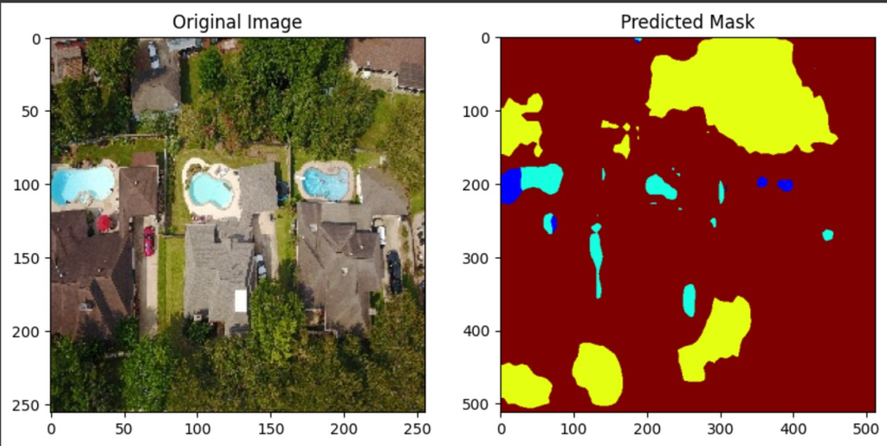
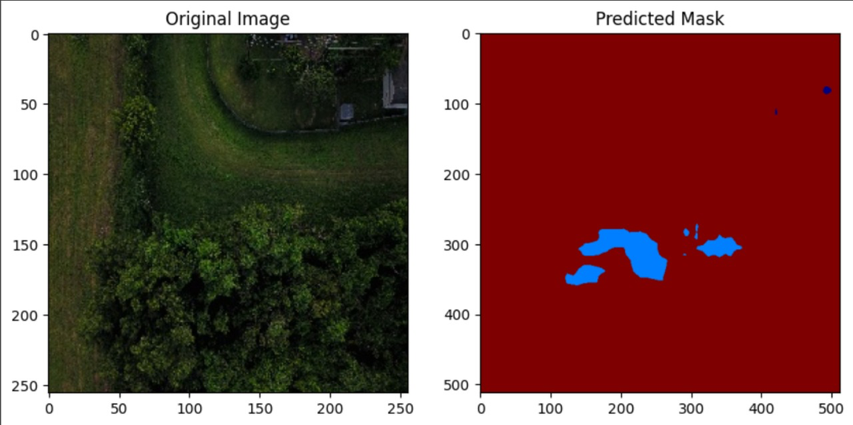
RESULT

Slide 10
FUTURE SCOPE
The task can be optimised by comparing and analysing segmentation models other than DeepLab-V3, which can perform better for different kinds of data.
This task is not only limited to flood mapping, it can also be extended to identifying and segmenting forest fires and area effected by the forest fires as well.
The segmentation model can be integrated with a Large Language Model. The input of the LLM model will be the segmented mask and prompts of the user to which the model will give a response based on the mask.

